Slide 1
Chinemerem Project
File created on: 5/31/2020 4:31:58 PM

Slide 2
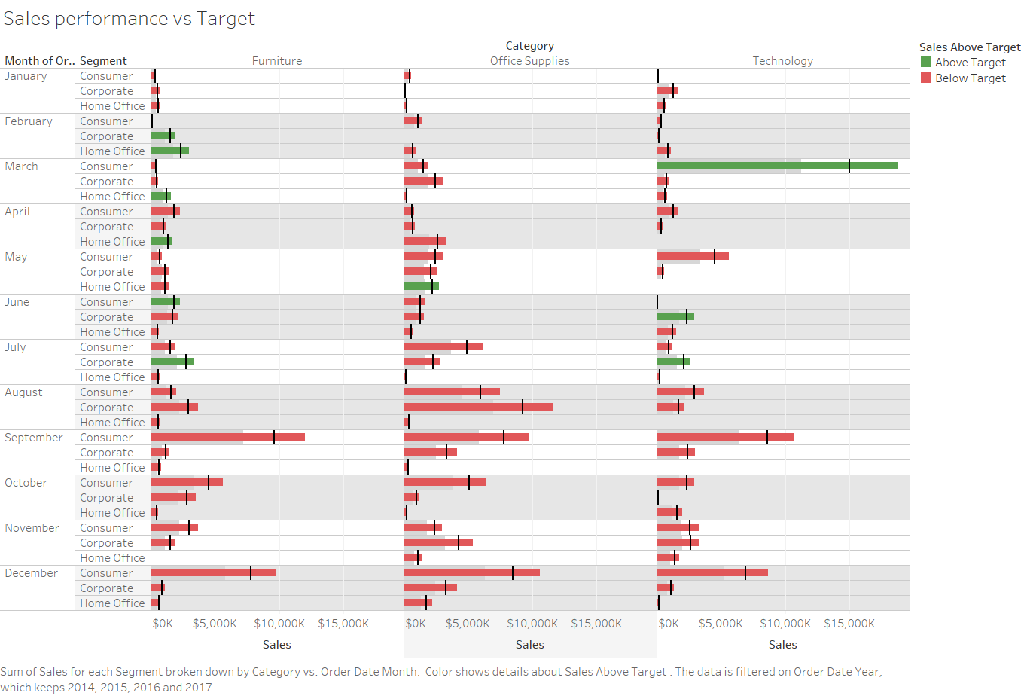

Slide 3
